Slide 1
DSC3013 Intro. to Social
Media Analytics (Lec. 8)
Hao PENG
Department of Data Science
City University of Hong Kong
https://haoopeng.github.io/

Slide 2
Topics for this week
Network Science
  Background
Characteristics of Social Networks
  Short average distance
  Social influence/hubs
  Strong and weak ties
  Community structure

Slide 3
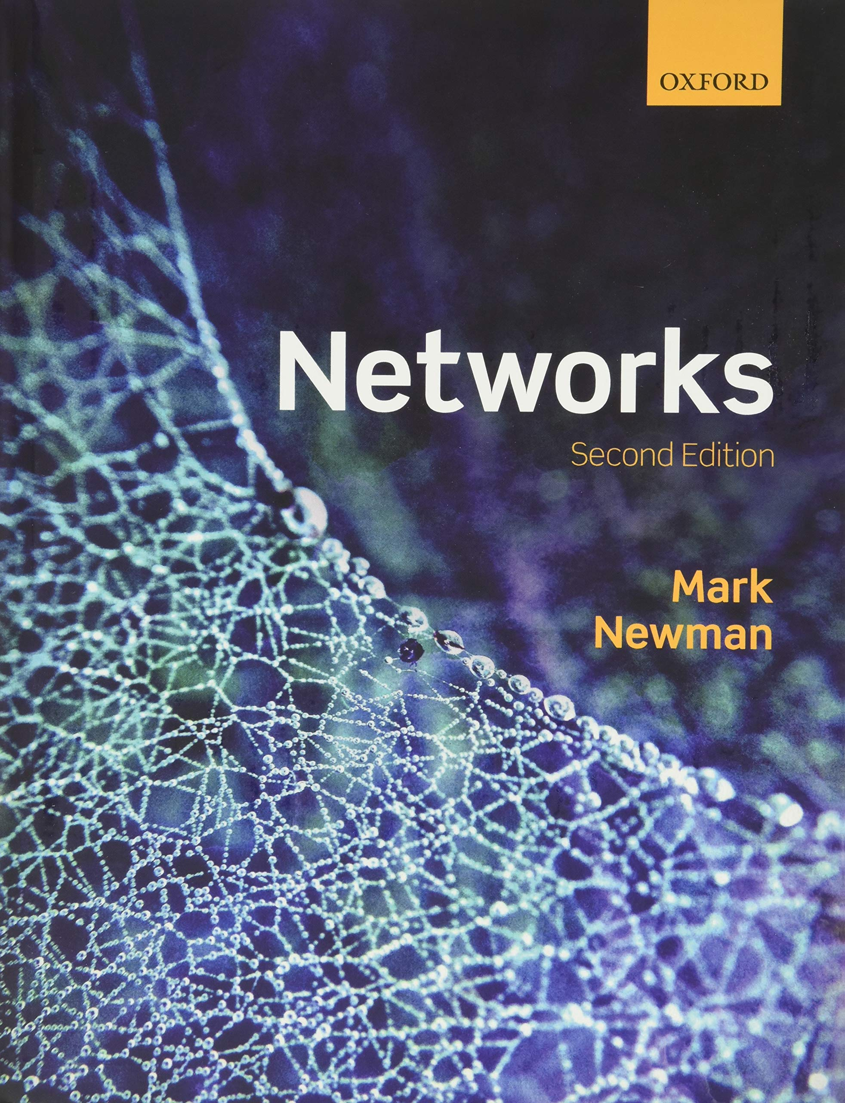
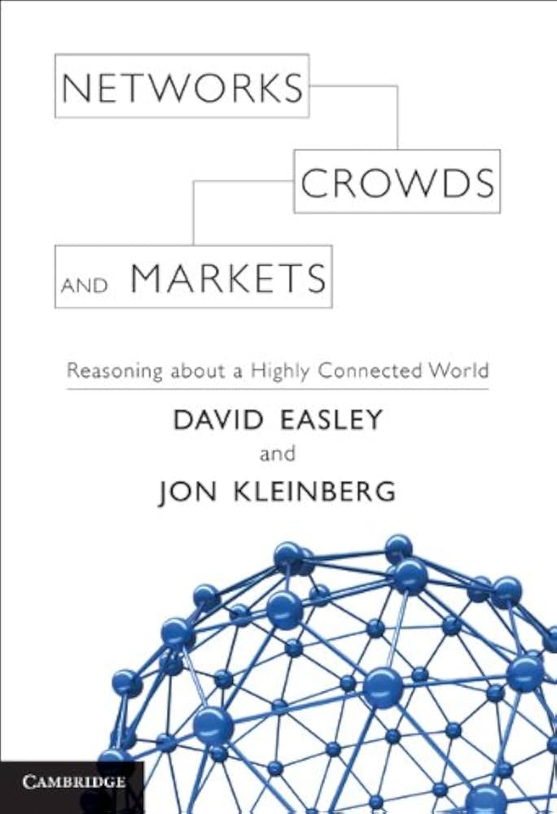
Network Science
Network science studies numerous real-world complex networks to understand their statistical properties, structure, and dynamics.
Related areas: graph theory, statistics, mathematics, control theory
Common examples include social networks, information networks, transportation networks, biological networks, transaction networks.
  We will focus on social and information networks in this class.

Slide 4
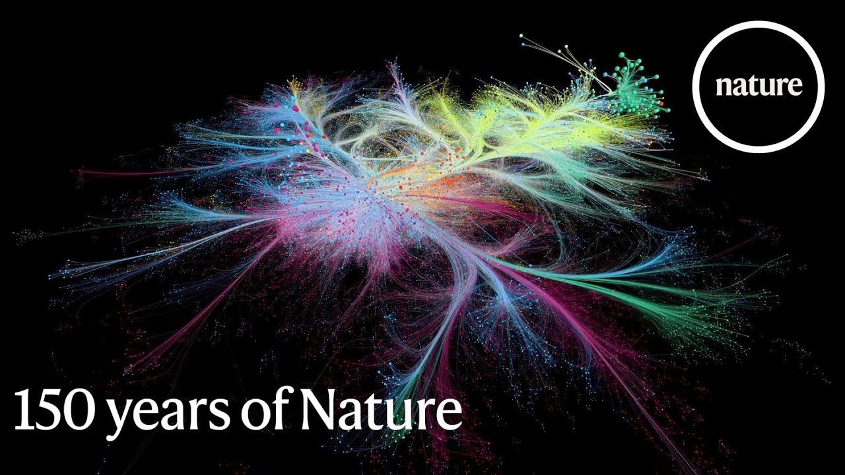
Information networks
Co-citation network among all Nature papers (color shows fields)

Slide 5
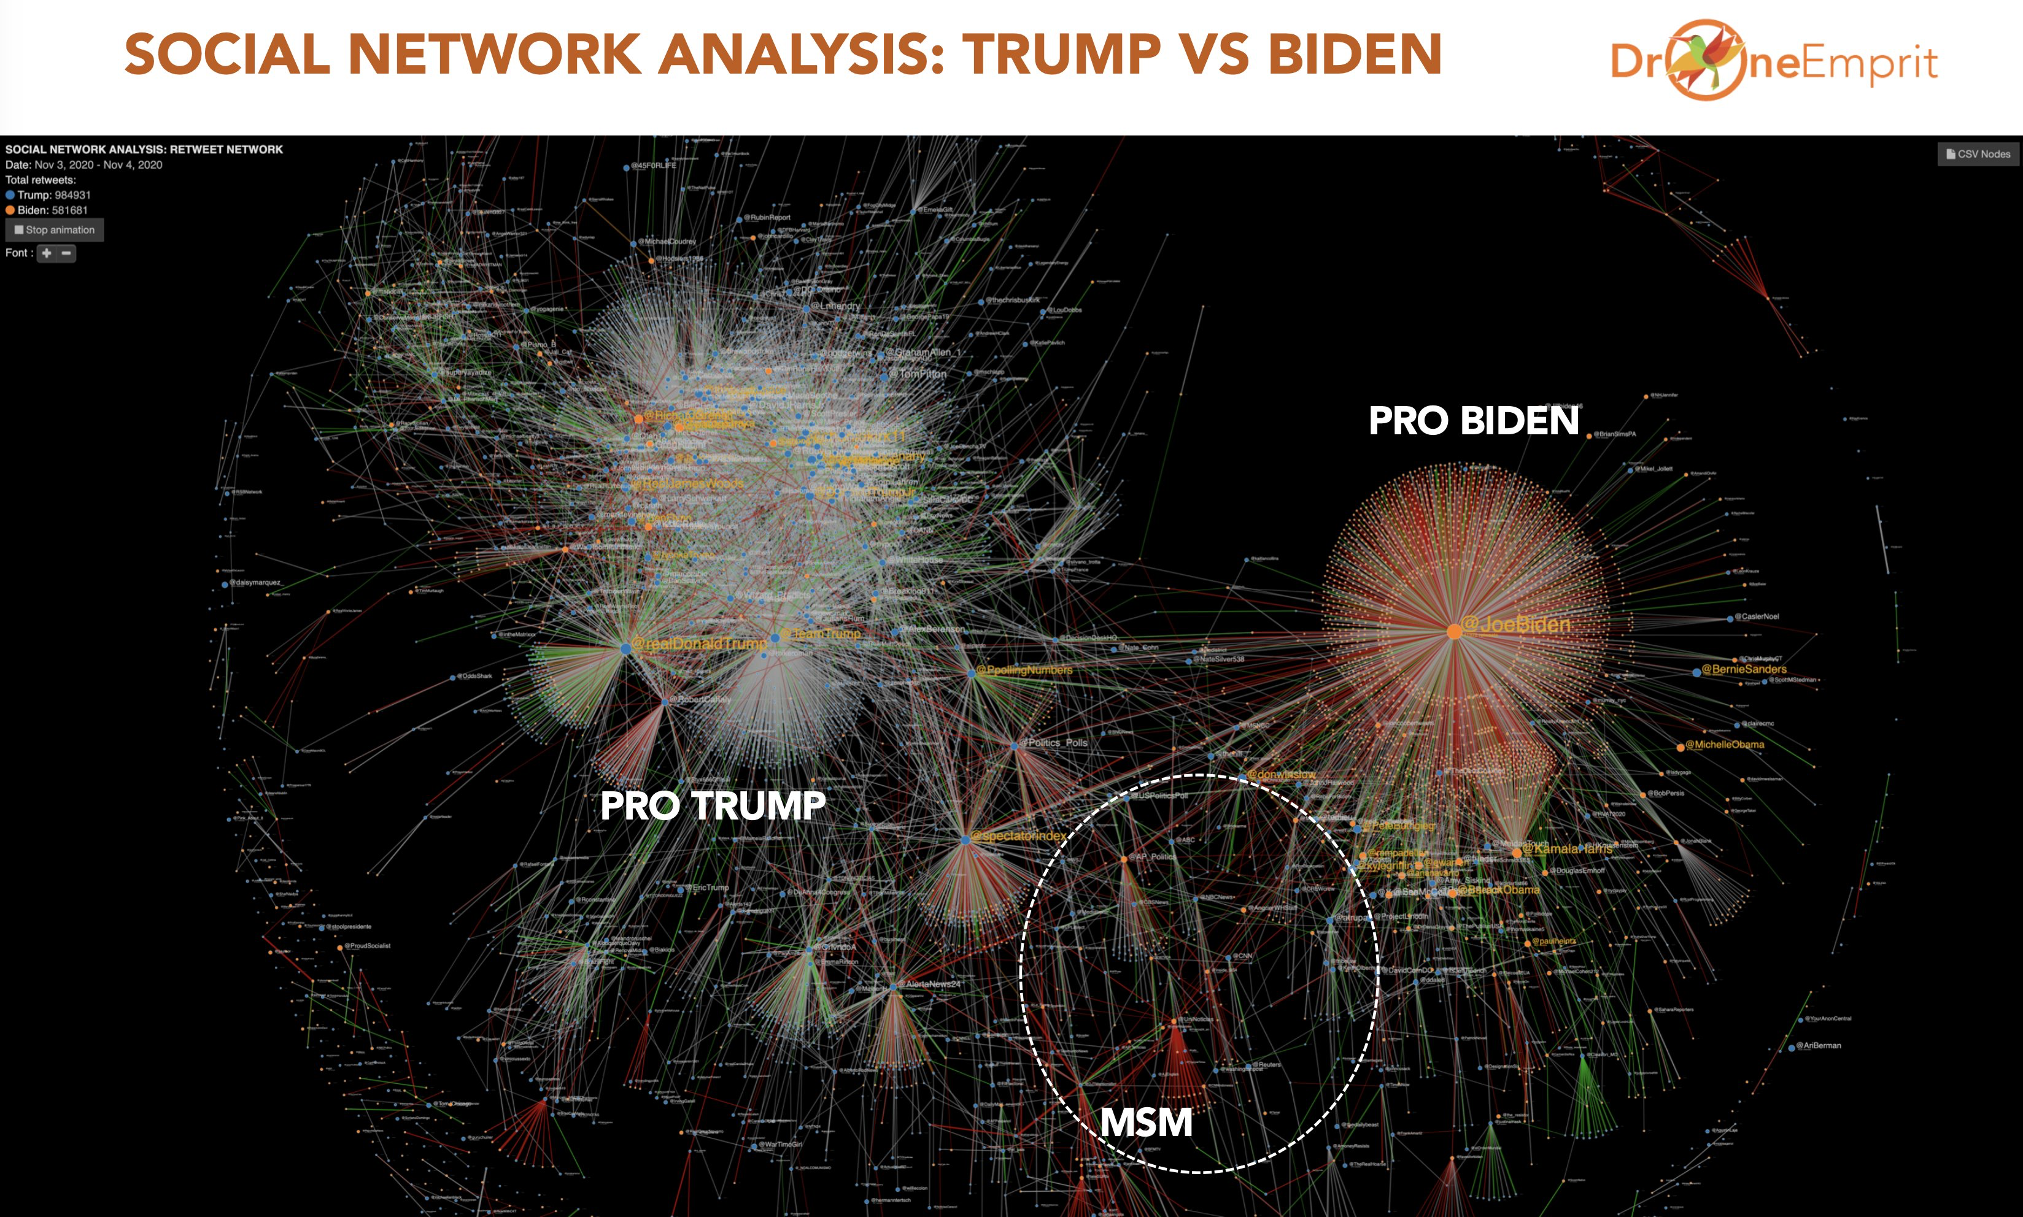
Information networks
Links represent retweets.
Mainstream Media (MSM) accounts connects Pro Trump and Pro Biden subgraphs.
Notes:
This SNA graph uses "retweet" as the link. Two big component subgraphs show Pro Trump and Pro Biden networks. Pro Trump subgraph is bigger than Biden's. Between them is a pool of MSM (mainstream media) accounts, closer to Biden's

Slide 6
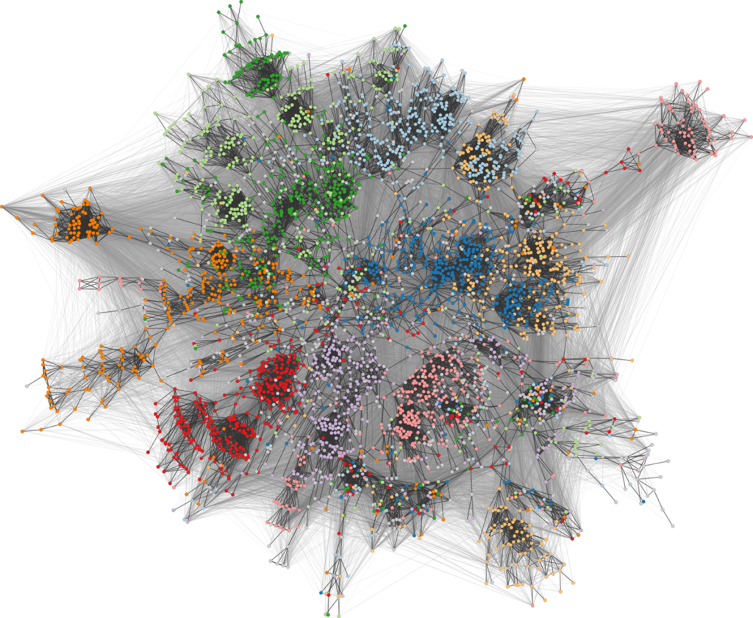
Social networks
Facebook network of university students (color shows dormitory)
Notes:
We can accurately infer roommate relationship (offline) from community labels (online).

Slide 7
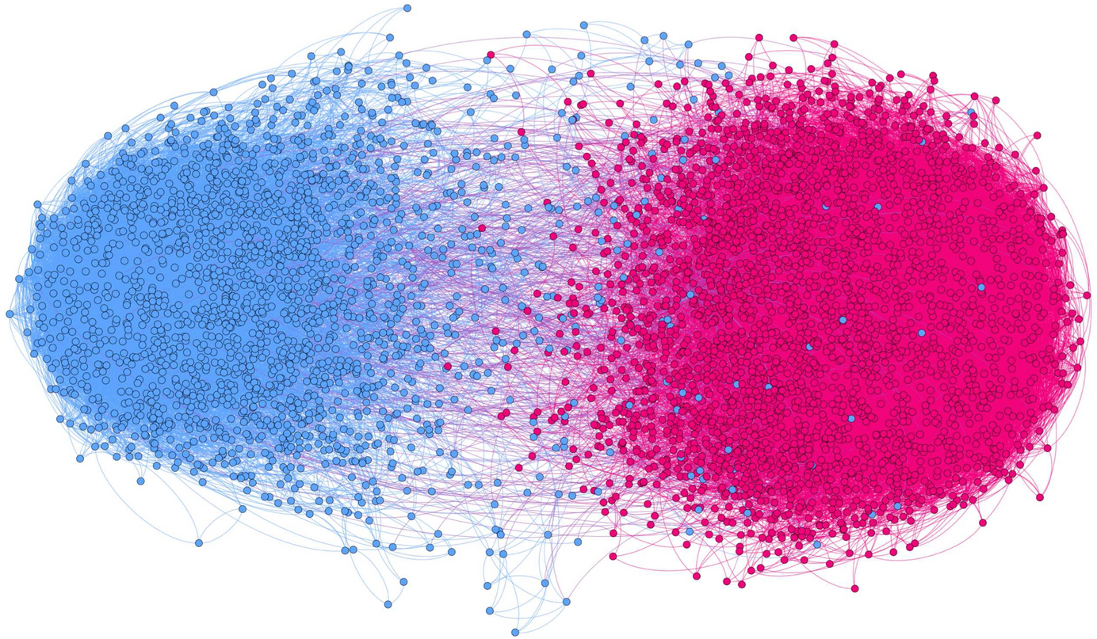
Social networks
The largest component of a polarized retweet network on Twitter based on several political hashtags (only shows nodes with k-core above 3 here).
That’s why we need statistical analysis, models, and algorithms to understand the complex structure of large social networks!
https://link.springer.com/article/10.1007/s42001-020-00084-7

Slide 8
Network definition & vocabulary
A representation of connections among a set of items.
Items are called nodes (or vertices / users)
Connections are called edges (or link / ties)
G
A
Different types of networks:
Undirected, directed
Weighted, unweighted
Connected, disconnected
B
C
F
D
Edge
E
Node

Slide 9
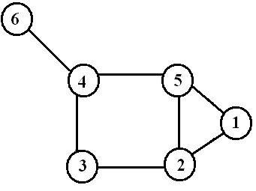
Degree of nodes
Number of edges incident on a node
The degree of node i: d(i)
d(6) = 1
d(4) = 3
d(5) = 3
d(1) = 2
d(3) = 2
d(2) = 3

Slide 10
Basic features of social networks
Short average distance
High clustering coefficient
Triadic closure
  friends of my friends are also my friends
Social influence & hubs
Strong and weak ties
Community structure
And many more….

Slide 11
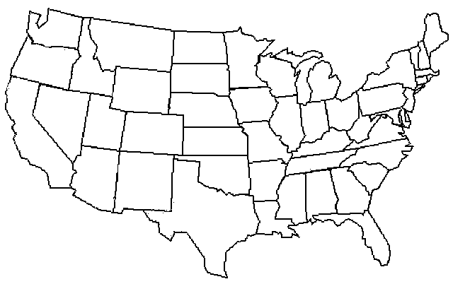
The small-world experiment
On average, it took only six steps to reach the target.
Fig: Baruch Barzel
J. Travers and S. Milgram, Sociometry 32,425–443 (1969)
https://en.wikipedia.org/wiki/Small-world_experiment
Notes:
You may have heard of this famous small world experiment conducted by …
They recruited hundreds of participants to send letters to a random person who lives in Boston.
Each participant was instructed to forward the letter to one of their close friends.

Slide 12
Six-degree replicated
Peter Sheridan Dodds, Roby Muhamad, and Duncan Watts replicated Milgram’s experiment with email:
18 targets in 13 countries
60,000 participants from 166 countries
“Targets included a professor at an Ivy League university, an archival inspector in Estonia, a technology consultant in India, a policeman in Australia, and a veterinarian in the Norwegian army.”
Average: 7 steps

Slide 13
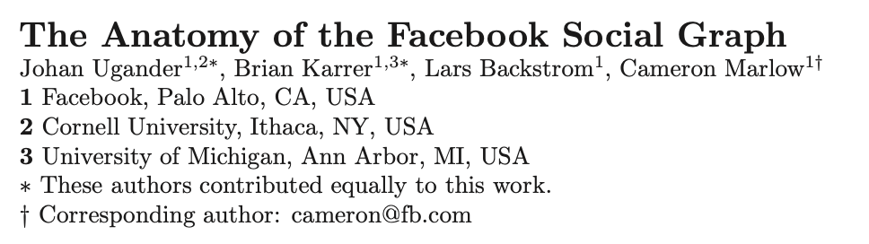
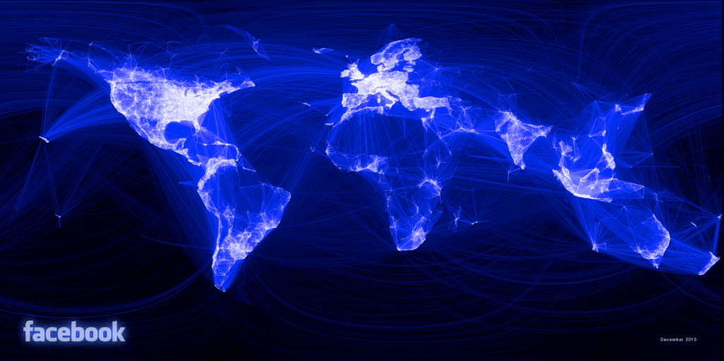
Even shorter distance on FB
Average distance on FB: 4.74 (world-wide) and 3.57 (U.S.)

Slide 14
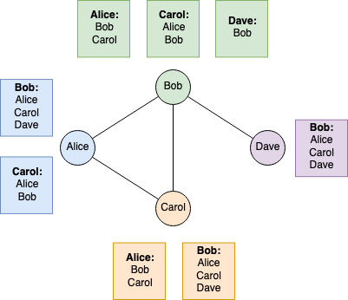
Friendship paradox
The phenomenon that an individual's friends have, on average, more friends than that individual has.
Do your calculation:
Notes:
k = (2+3+1+2) / 4 = 2
Friends’ k = (3+2+2+2+1+3+2+3) / 8 = 2.25

Slide 15
Finding hubs and influentials
Which nodes are the most important?
Suppose you are going to give away free tickets to your show
Who should you give them too?
Suppose you can pay someone to TikTok about your product
Who should you pay?
Suppose you want to be elected to a position
Whose endorsement will help you the most?
Notes:
Maybe because viral information is initially started by important nodes in the network.

Slide 16
Measures of node centrality
Degree centrality
PageRank centrality
Betweenness centrality
Closeness centrality
Eigenvector centrality
…
Which is best depends on the problem you are studying.

Slide 17
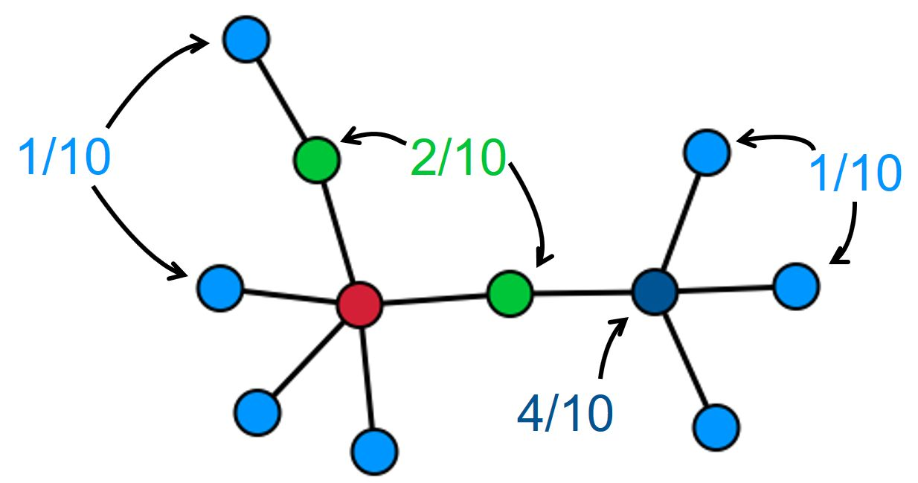
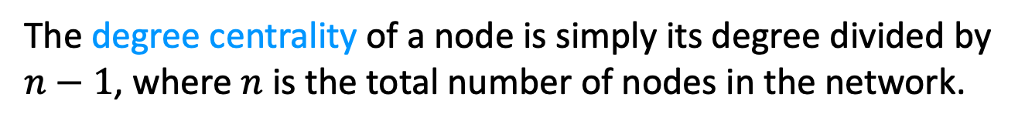
Degree centrality
The degree centrality of a node is simply its degree divided by $n−1$, where $n$ is the total number of nodes in the network.
When would this be a good measure of influence?
When/why might it not be a good measure of influence?
Notes:
For popularity
For scientific impact (citation): hard to rank papers with the same citation count. A citation from Nature may be more important than others.

Slide 18
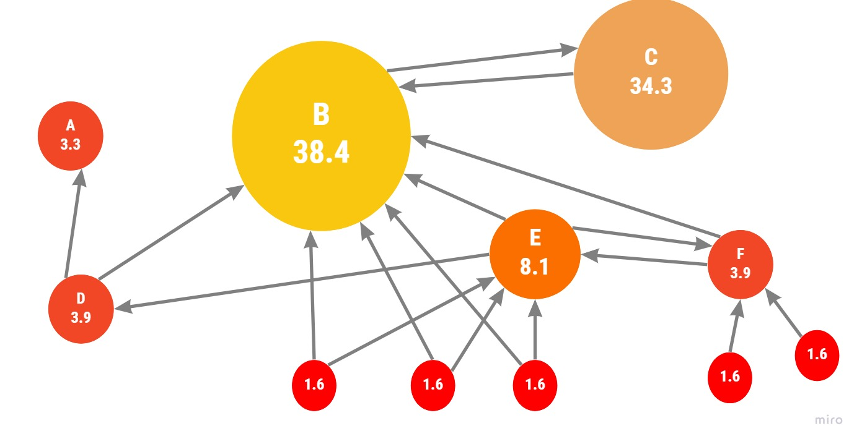
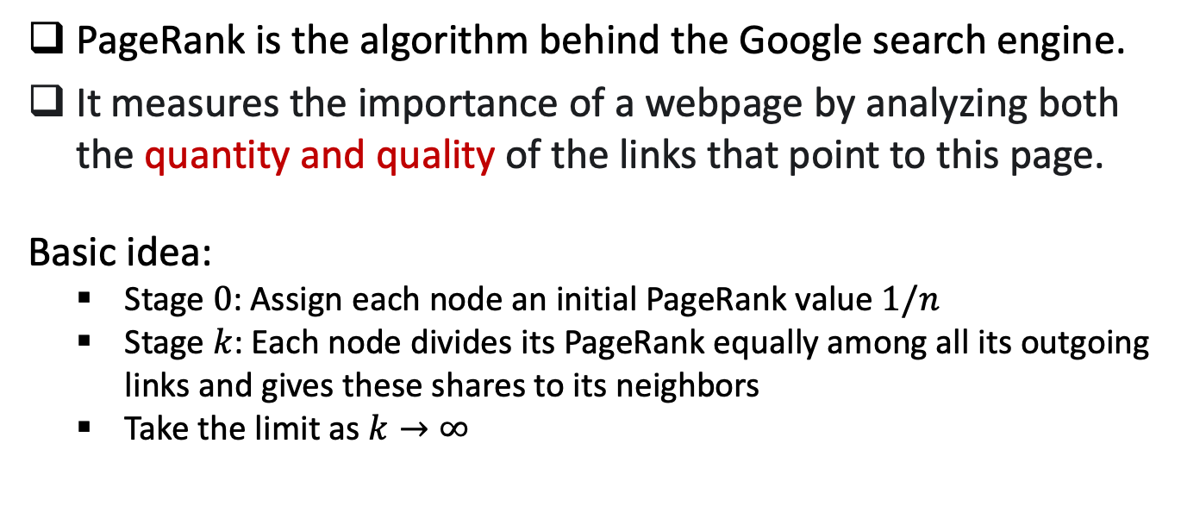
PageRank algorithm
PageRank is the algorithm behind the Google search engine.
It measures the importance of a webpage by analyzing both the quantity and quality of the links that point to this page.
Basic idea:
  Stage $0$: Assign each node an initial PageRank value $1/n$
  Stage $k$: Each node divides its PageRank equally among all its outgoing links and gives these shares to its neighbors
  Take the limit as $k→∞$

Slide 19
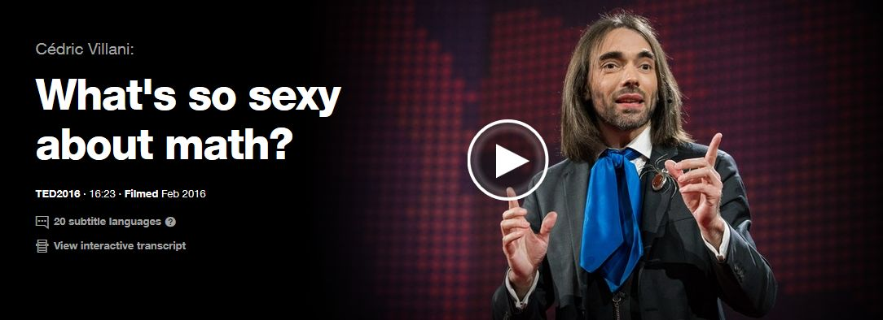
PageRank algorithm
https://www.ted.com/talks/cedric_villani_what_s_so_sexy_about_math
Watch video starting at minute 6:50

Slide 20
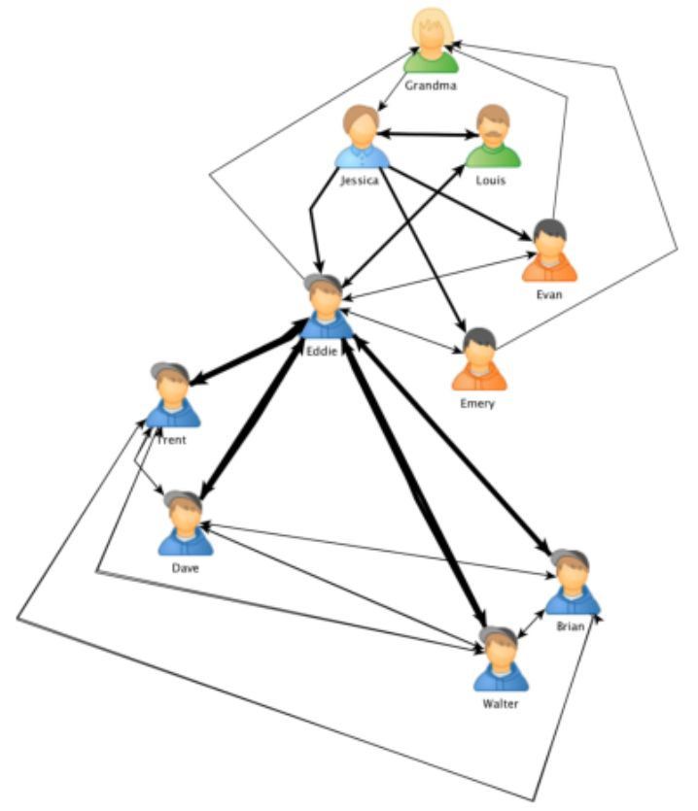
Betweenness centrality
The betweenness centrality of a node is calculated as the number of shortest paths of all pairs of nodes that pass through that node. It can measure the importance of nodes connecting different communities.
Notes:
  Computation is very costly;
  Nodes with high betweenness centrality scores are often called “broker”;
  Broker plays a crucial role in exchanging information between communities;
Fig: Zaki Mohamed Hussain

Slide 21
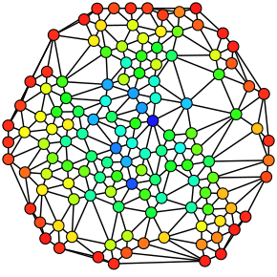
Betweenness centrality
Sometimes called “structural hole”, “bridge”.
Can be used to reflect power, social capital.
Real networks are vulnerable to attacks on brokers and hubs.
Fig: A network of nodes colored based on the betweenness centrality of each node from least (red) to greatest (blue).

Slide 22
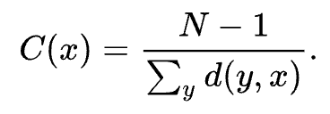
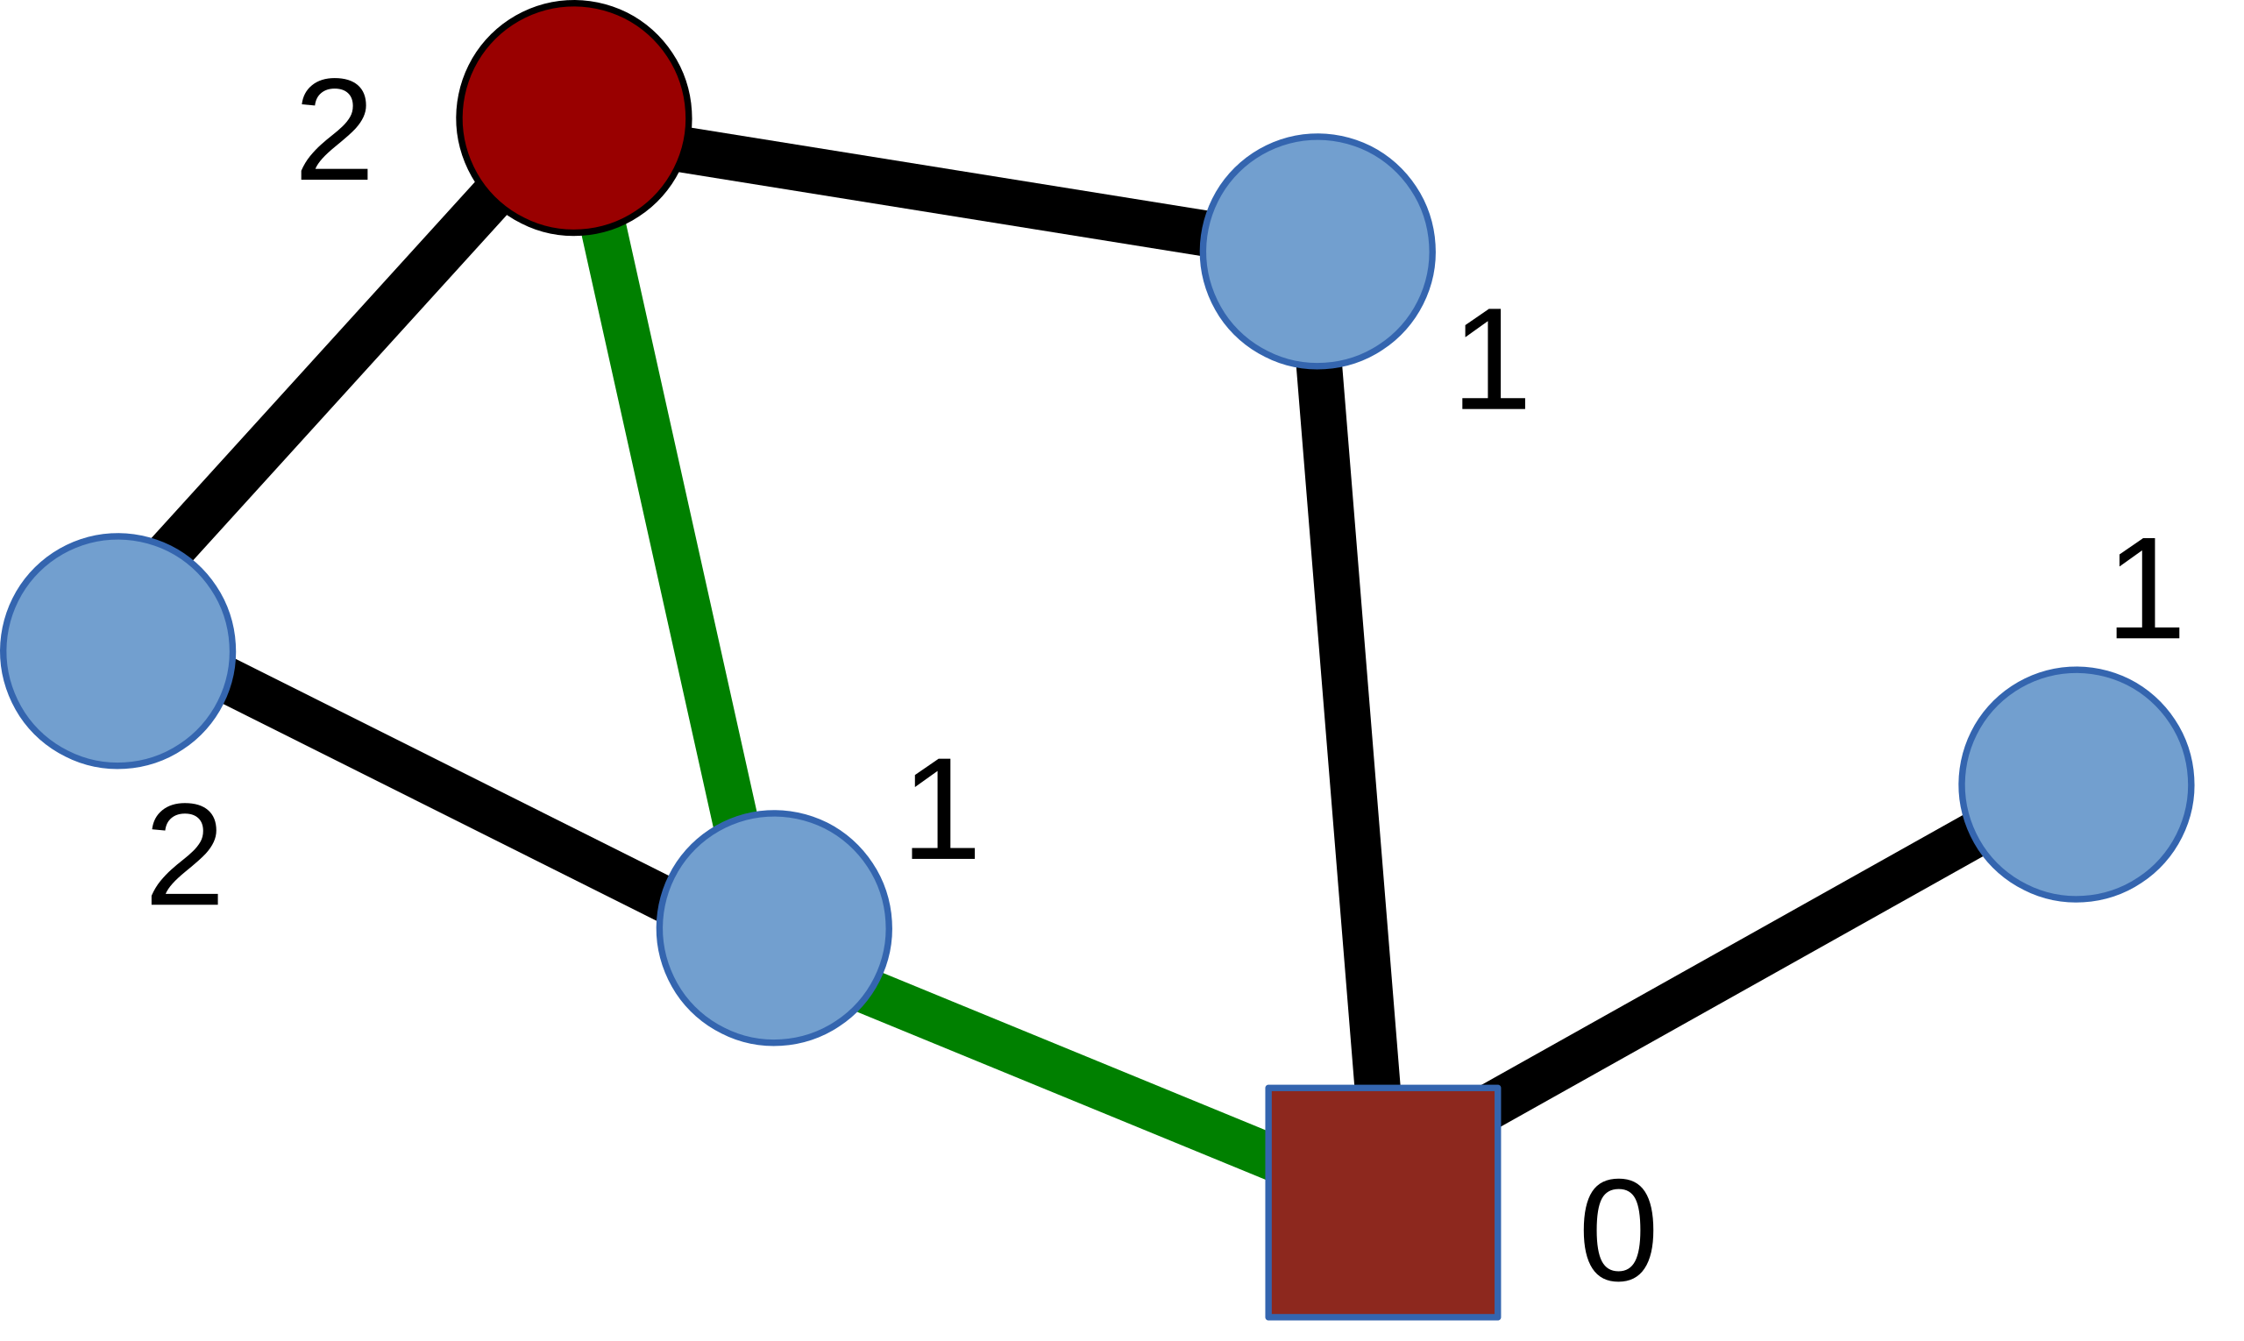
Closeness centrality
The closeness centrality of a node is calculated as the inverse of its avg shortest distance between the node and all other nodes in the network. The more central a node is, the closer it is to all other nodes.
  The green edges illustrate one of the two shortest paths between the red square node and the red circle node.
  Closeness of the square node: 5/(1+1+1+2+2) = 5/7

Slide 23
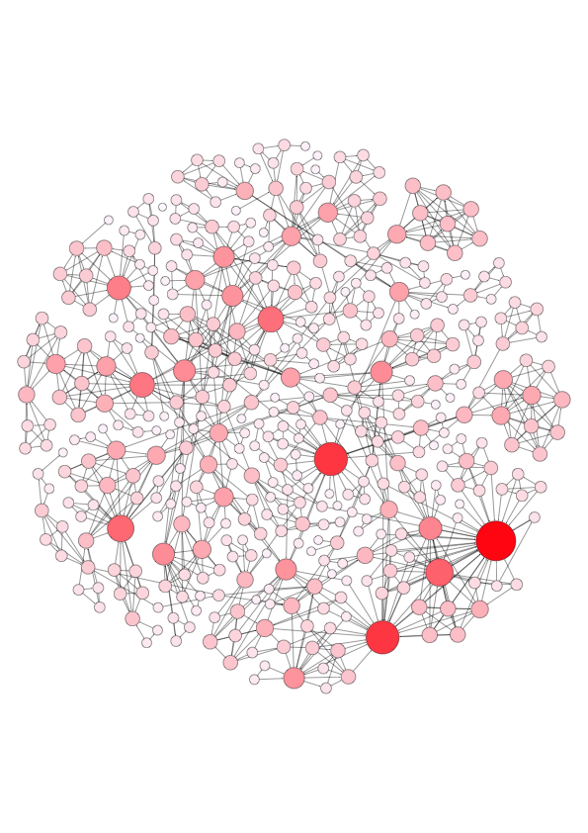
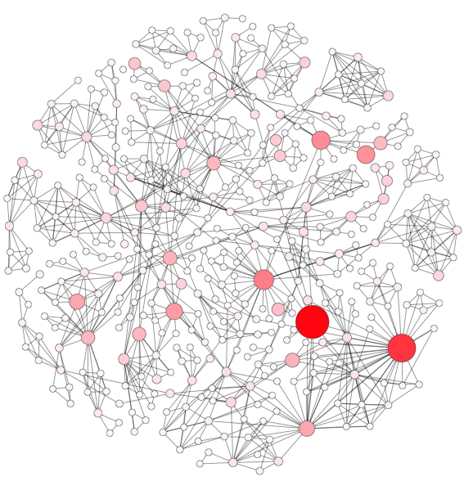
Comparing different measures
Degree centrality
PageRank
In what social scenarios should we use degree centrality?
What about the PageRank centrality? Give real examples.
Notes:
Important nodes identified by PR are quite different from that identified by DC.

Slide 24
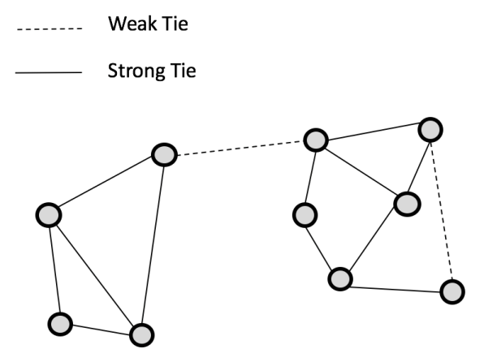
Strong ties and weak ties
Measured by edge weights such as the contact frequency, the number of mutual friends, instead of structural positions.
Strong ties are often within communities; weak ties often connect different communities.
(Frequency definition)

Slide 25
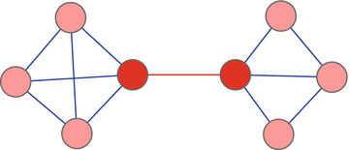
Edge betweenness centrality
Betweenness centrality of an edge is the number of all-pairs shortest paths that pass through the edge.
Weak ties (based on contact freq.) often have high betweenness centrality, thus are structurally more important than strong ties.
(Structural definition)
Notes:
To identify influentials

Slide 26

Quick survey
Who will you reach out for finding a job?
  Close friends
  Acquaintance
  Someone you don’t know much about but somehow can connect you to a different social circle.

Slide 27
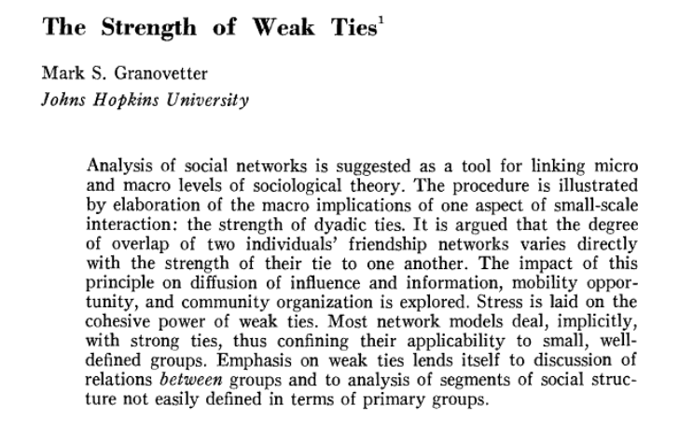
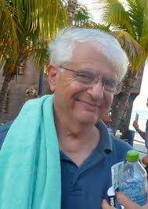
Strength of weak tie (classic theory)
The idea that people often land jobs via weak connections.
One of the most (missed) influential ideas in social sciences.
https://www.jstor.org/stable/2776392
https://www.youtube.com/watch?v=g3bBajcR5fE

Slide 28
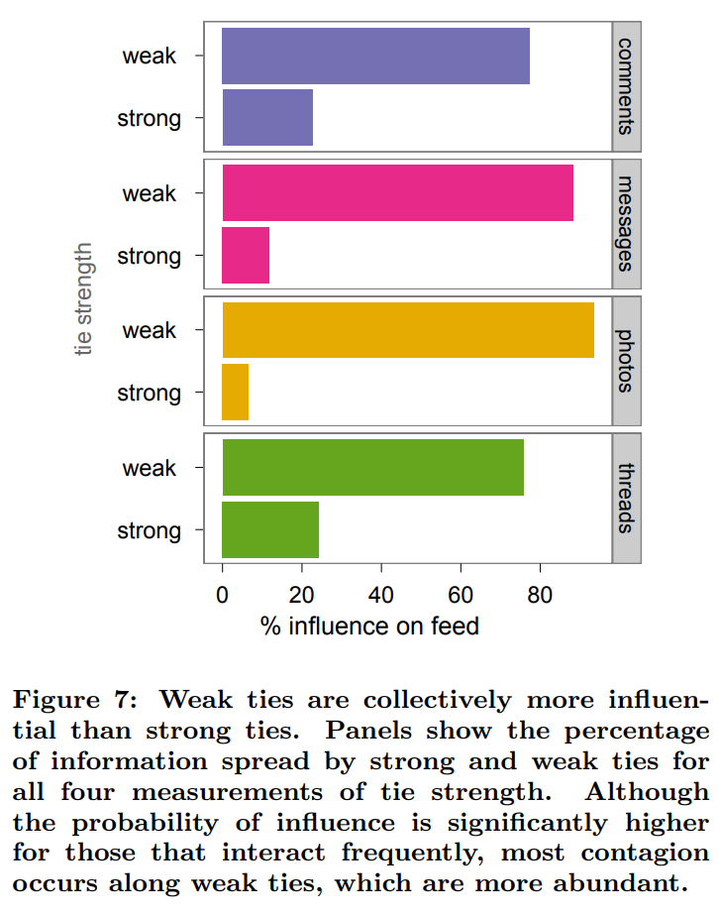
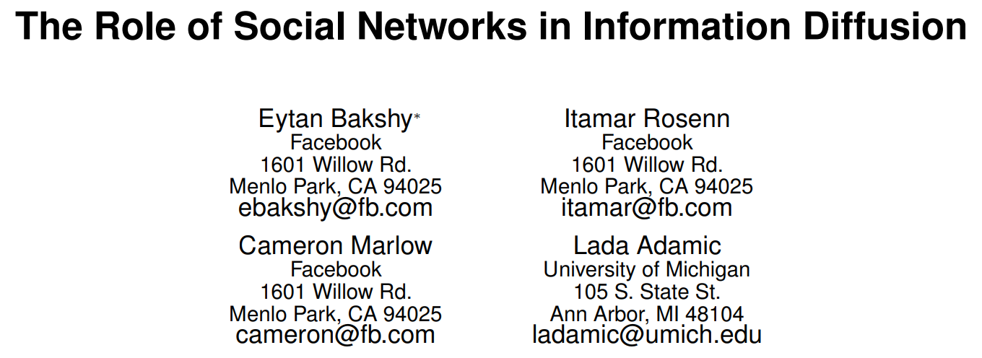
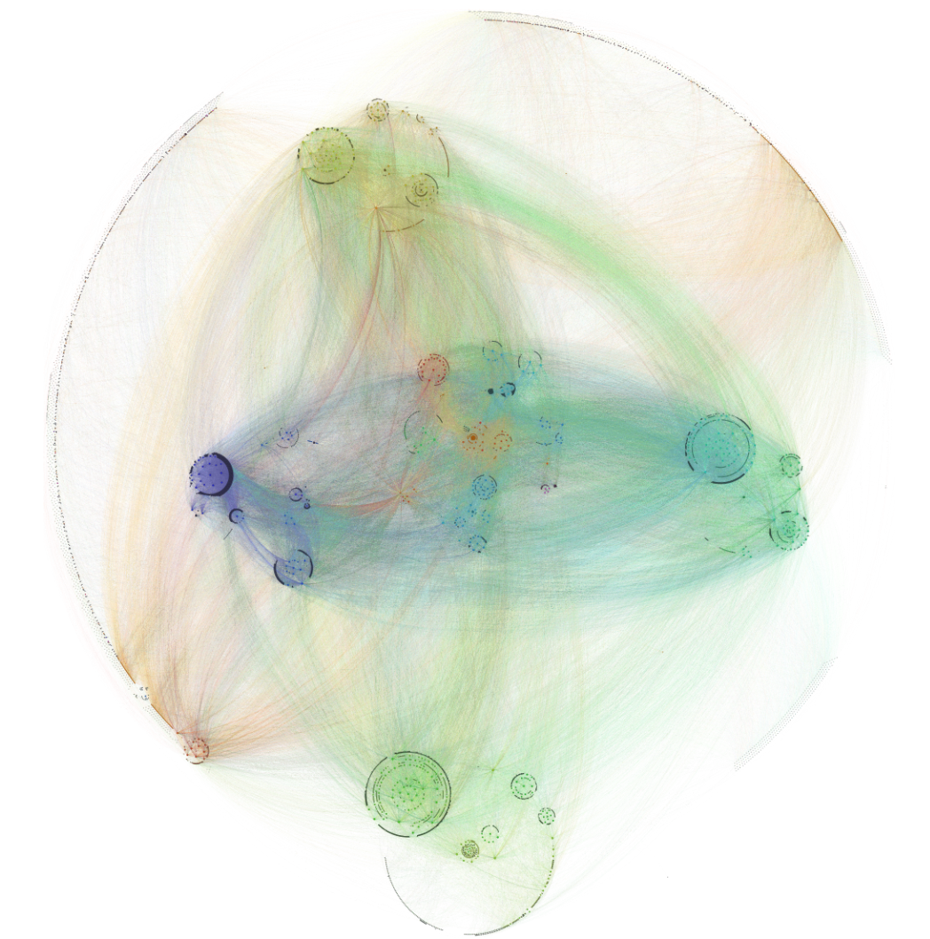
Evidence (observational) on Facebook

Slide 29
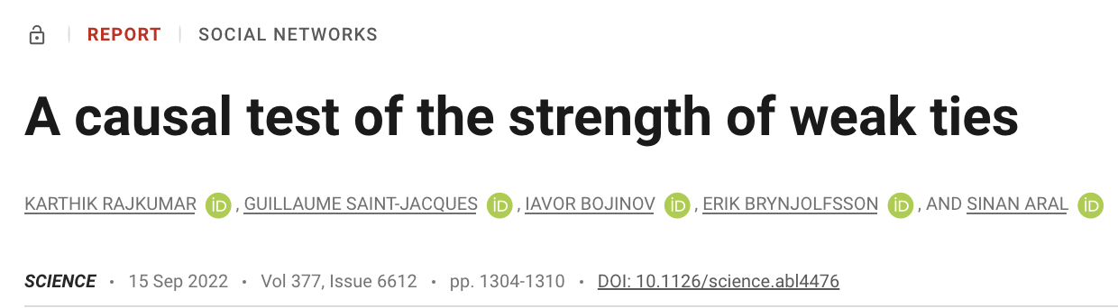
Replicated by LinkedIn experiment
A “delayed” causal test of this paradoxical theory;
Largest randomized experiments conducted on LinkedIn’s “People You May Know” algorithm;
The weakest ties had the greatest impact on job mobility, whereas the strongest ties had the least effect.

Slide 30

Link prediction
Given a network snapshot, the task is to predict new links among all nodes that are likely to occur in the future.
Often use topological features to measure node proximity:
  Network distance
  Common neighbors
  Jaccard’s coeﬃcient: score(x, y) = |Γ(x) ∩ Γ(y)|/|Γ(x) ∪ Γ(y)|
  Adamic and Adar score:
  And more ...
Can also include node-level features:
  Gender, age, political orientation
  Activity level, language use, profile image, …
Nowell and Kleinberg. “The Link-Prediction Problem for Social Networks.” CIKM 2003.
Notes:
Disciplinary and interdisciplinary relationships

Slide 31


NetworkX
A Python package to create, manipulate, and study the structure, dynamics, and functions of complex networks.
NetworkX has the capacity to operate on very large graphs with more than 10 million nodes and 100 million edges.

Slide 32
A survey on collaboration network
Take this survey (Scan the QR code):
  This serves as an attendance check!
  If missing: 5 pts penalty on Project Presentation (Weight: 20%)
Download data from Canvas after everyone is done.
Notes:
https://forms.gle/AkytuxkNGscB25Jh6

Slide 33

A survey on collaboration network
Take this survey (Scan the QR code):
  This is our first attendance check!
  If missing: 5 pts penalty on Project Presentation (Weight: 20%)
Download data from Canvas after everyone is done.
Notes:
https://forms.gle/AkytuxkNGscB25Jh6

Slide 34
Group exercise
Group activities:
  Build and visualize the network in Python NetworkX.
  Color nodes by attributes (e.g., gender), size by degree centrality.
  Compute different node centrality measures.
Group presentation on interesting findings:
  Who are the central "hubs"? Bridges?
  How many communities are there?
  Is there homophily effect in the network?
Group Project Coordination & Discussion
Notes:
Important nodes identified by PR are quite different from that identified by DC.

Slide 35
Course notes
Everyone gets a penalty free late submission
  Up to 3 days
  No need to ask for it
Apps of Social Networks Analysis (SNA)
  HW2 will be released
  Tutorial 5: link prediction
SMA Ethics next week

